Slide 1
CSSE 332 Advanced Page Tables

Slide 2
Questions
What Is the problem with page table?
Solutions:
Multi-index Page Table
Inverted Page Table

Slide 3
Virtual Memory Space
Physical Memory Space
0000
0001
0010
0011
0100
0101
0110
0111
1000
1001
1010
1011
1100
1101
1110
1111

Slide 4
Virtual Memory Space
0000
0001
0010
0011
0100
0101
0110
0111
1000
1001
1010
1011
1100
1101
1110
1111
Virtual Memory Address
01 01
Page
Number
Offset
Page Table Address
Valid,Frame#
1 | 10
1 | 00
1 | 11
0 | 01
00 01
Physical Memory Address
Frame
Number
Offset

Slide 5

Divide virtual address space into fixed sized pages
Each page maps to a physical page frame or PFN
PFN 00
PFN 01
PFN 02
PFN 03
PFN 04
PFN 05
PFN 06
PFN 07
PFN 08
PFN 09
PFN 0A
PFN 0B
PFN 0C
PFN 0D
PFN OE
PFN 0F
...
PFN FE
PFN FF
Problem
valid | 0C
valid | 0D
invalid
invalid
invalid
invalid
invalid
Invalid
Invalid
Invalid
Invalid
Invalid
Invalid
Valid | F1
valid | F2
valid | 0F
Stack | Page 0
Stack | Page 1
Free | Page 2
 | Page 3
 | Page 4
 | Page 5
 | Page 6
 | Page 7
 | Page 8
 | Page 9
 | Page A
 | Page B
 | Page C
Heap | Page D
Data | Page E
Code | Page F

Slide 6


Divide virtual address space into fixed sized pages
Each page maps to a physical page frame or PFN
PFN 00
PFN 01
PFN 02
PFN 03
PFN 04
PFN 05
PFN 06
PFN 07
PFN 08
PFN 09
PFN 0A
PFN 0B
PFN 0C
PFN 0D
PFN OE
PFN 0F
...
PFN FE
PFN FF
Solution: 2-level page table
valid | 0C
valid | 0D
invalid
invalid
invalid
invalid
invalid
Invalid
Invalid
Invalid
Invalid
Invalid
Invalid
Valid | F1
valid | F2
valid | 0F
Stack | Page 0
Stack | Page 1
Free | Page 2
 | Page 3
 | Page 4
 | Page 5
 | Page 6
 | Page 7
 | Page 8
 | Page 9
 | Page A
 | Page B
 | Page C
Heap | Page D
Data | Page E
Code | Page F
yes
no
no
yes

Slide 7
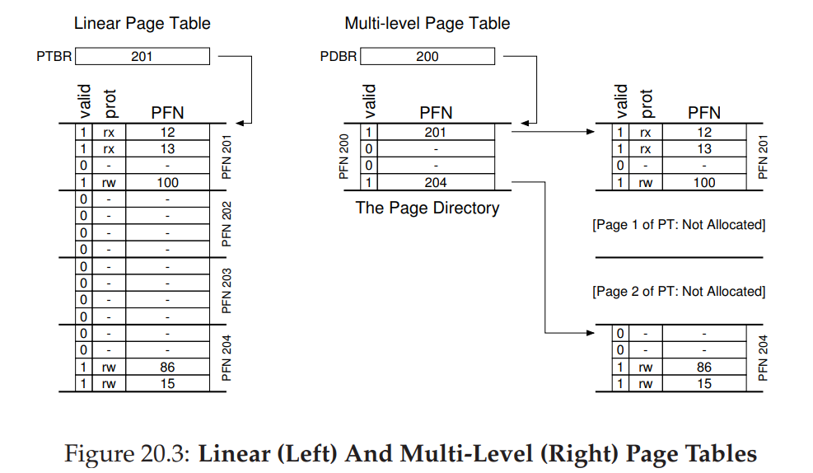

Slide 8
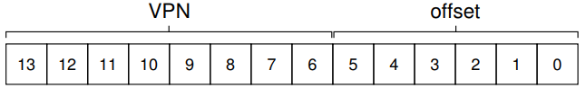
Design 2-Level Page Table
Imagine a small address space of size 16KB, with 64-byte pages. Thus, we have a 14-bit virtual address space, with 8 bits for the VPN and 6 bits for the offset.
Full regular page table (in this example) has 256 entries; assume each PTE is 4 bytes in size. Thus, our page table is 1KB (256 × 4 bytes) in size. Given that we have 64-byte pages, the 1KB page table can be divided into 16 64-byte pages; each page can hold 16 PTEs.
Make PTEs (Page Table Entry) on the same page as a group.
Then, VPN can break into Index_0 (select a group)|Index_1(select a page in that group)

Slide 9
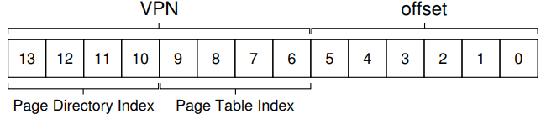

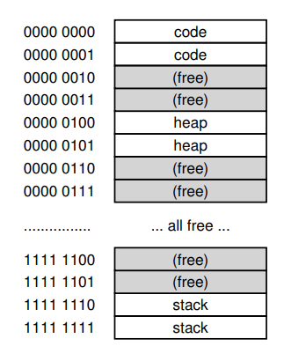
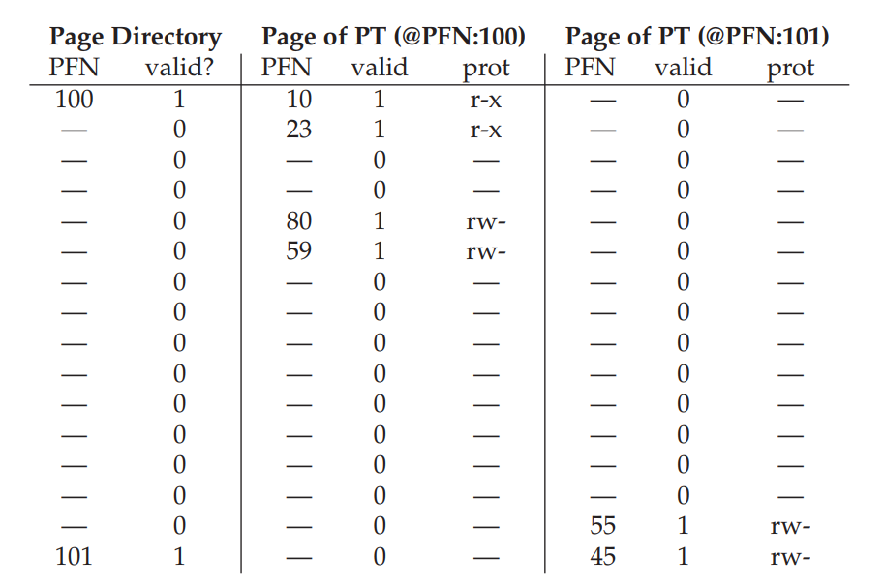
Design 2-Level Page Table (cont.)

Slide 10
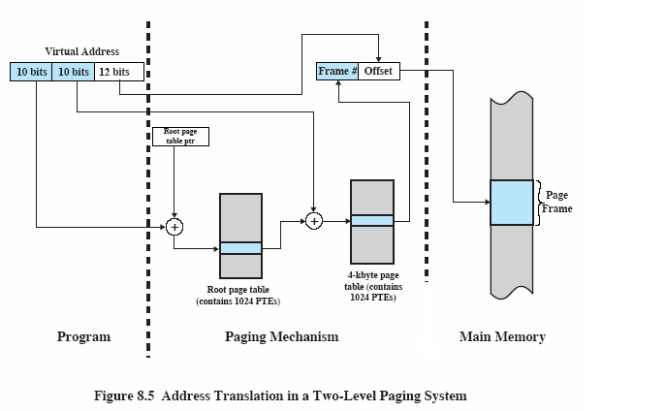
2-level Paging System Summary

Slide 11
Why do 2 level page tables save memory?
Most processes don’t use anywhere near the max memory they can. A 32-bit process has an address space of 4GBs. A 48-bit address space has an address space of 281 TBs
In a 1-level page table, we need an entry for every possible page. But if your process uses (say) only 100MB of memory the majority of these entries are unmapped
In a 2-level page table, each entry in the root table represents a large range of pages (1024 pages in 32 bit, 4MB). If all of them are unmapped, we don’t have to actually store the 2nd level page entries because we can mark the whole range as unmapped in the root table
In 32-bit x86, the root page table is 4KB. It would be 4MB if we only had 1 level paging.

Slide 12
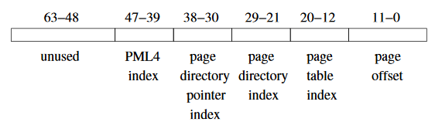
X86 64 - Question
64 bit x86 addressing uses 4-level paging. The root page table is 4KB.
Imagine instead it used 1-level paging, assuming 8byte PTEs and 4KB pages. Limit the address size to 48 bits.
How big would the page table for every process be?

Slide 13
X86 64 - Answer
4KB pages make for 12 bit page offsets. That leaves 36 bits of page number, or 2^36 page table entries. Each page table entry is 2^3 bytes, so 2^39 bytes used
Approximately 550GB

Slide 14
Pros and cons
The more levels of our paging system, the smaller we can shrink the memory size of the minimum process
But the more memory reads required read a page that we haven’t read recently…hopefully recently used pages will be stored in the TLB

Slide 15
Now do the Advanced Paging Activity
As usual you can see the answers after you’re done and resubmit

Slide 16
Inverted Page Table
Instead of asking each process maintain a page table for itself, OS can have a single table to track the mapping for each frame.
Hence it is of a fixed size.
Each entry in the table stores which page of what process <PID, VPN> the current frame is mapping to.

Slide 17
Inverted Page Table (cont.)
Virtual Address
Physical Address
Page #
Offset
Frame #
Offset
Inverted
Page Table
Page Frame
Frame #
<PID, Page #>
Search
V
M
PID,Page #
matches Page #
and PID
Program
Paging Hardware
Memory

Slide 18
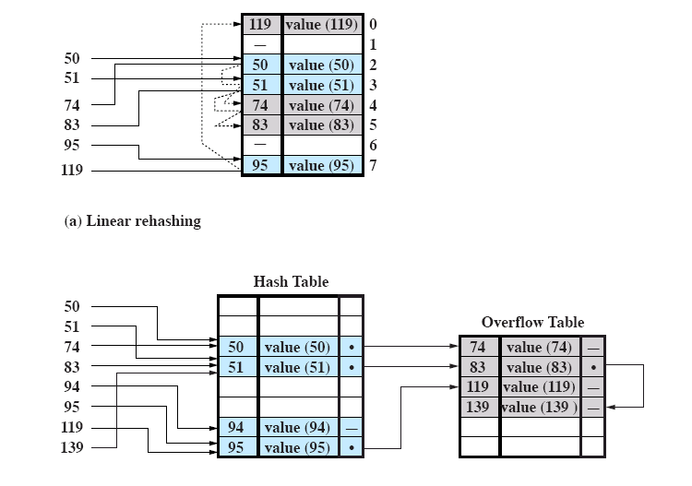
Inverted Page Table (cont.)
BUT searching this gigantic table is slow.
Let’s hash.
Hashing function: X mod 8
(b) Chained rehashing

